Slide 1
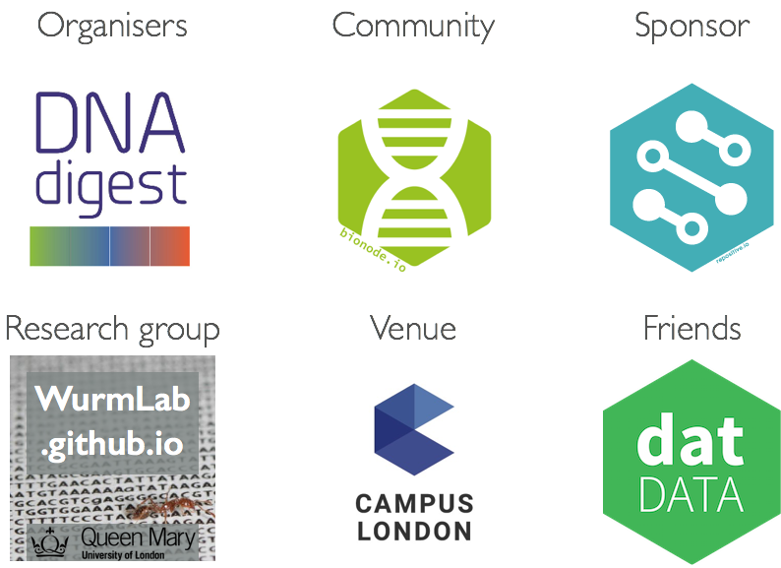

Slide 2
http://hack.bionode.io
Please join the bionode-hack github organisation
http://github.com/bionode-hack
github organisation homepage
http://gitter.im/bionode-hack/discussions
Instant messaging and general discussions
#bionodehack
#genomics
#nodejs
#campuslondon
@DNADigest
@bionode
@repositiveio
@CampusLondon

Slide 3



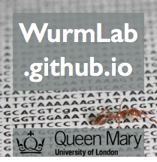


Network: Campus Community
Password: dotheimpossible
#bionodehack
#genomics
#nodejs
#campuslondon
@DNADigest
@bionode
@repositiveio
@CampusLondon

Slide 4
http://hack.bionode.io
Please join the bionode-hack github organisation
http://github.com/bionode-hack
github organisation homepage
http://gitter.im/bionode-hack/discussions
Instant messaging and general discussions
#bionodehack
#genomics
#nodejs
#campuslondon
@DNADigest
@bionode
@repositiveio
@CampusLondon

Slide 5
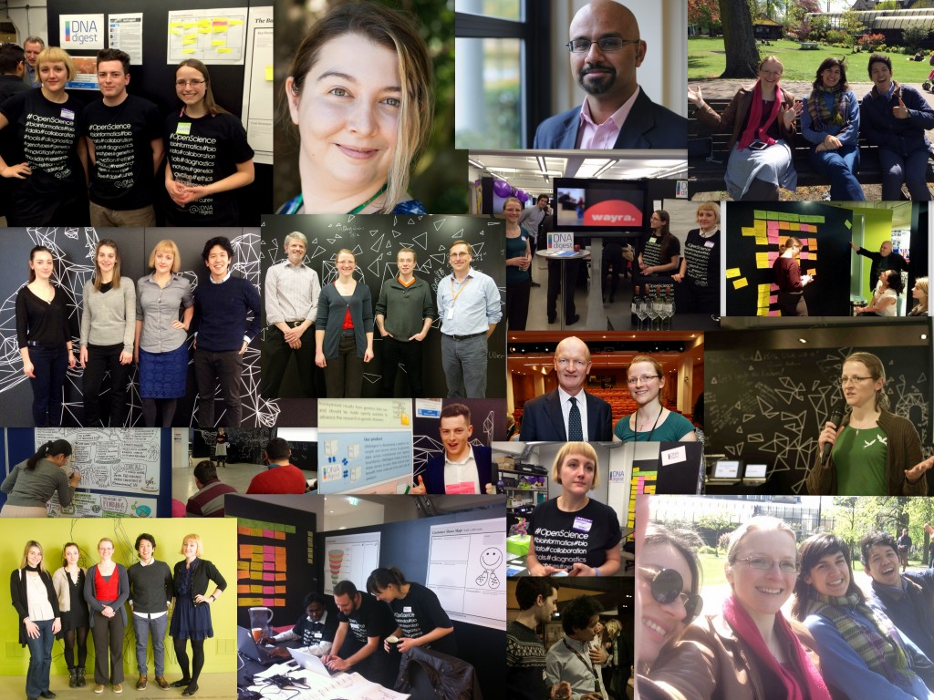
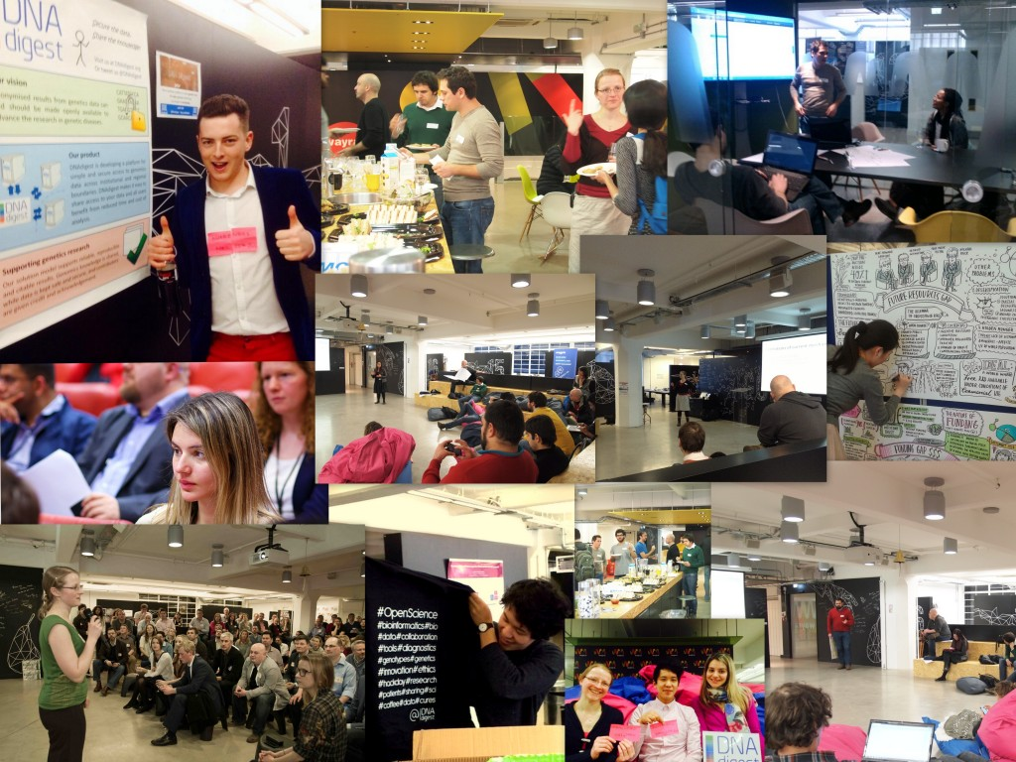
Who and what is DNAdigest?
#BionodeHack

Slide 6
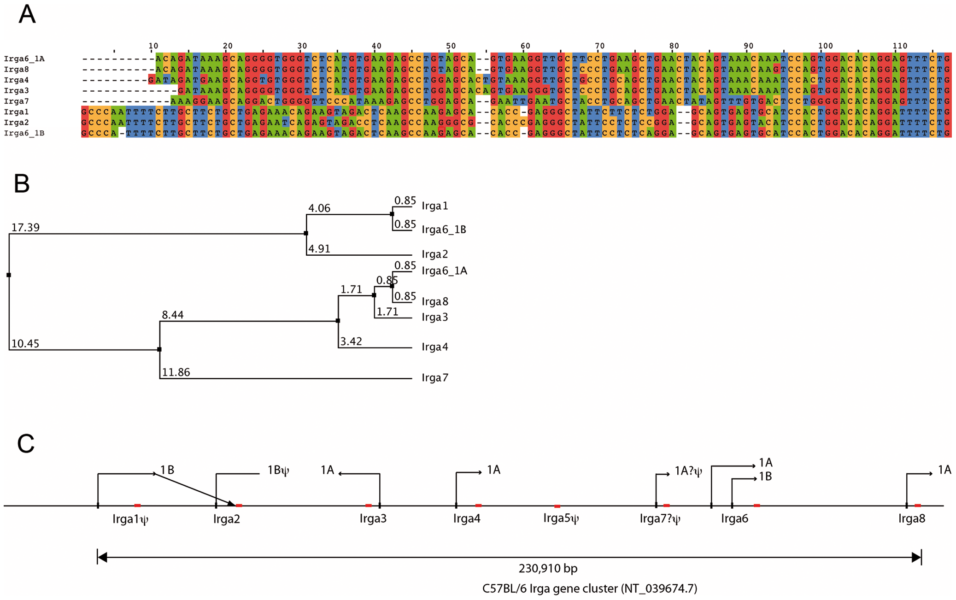
What is DNA data? Why care?
DNA interpretation is hard
All information comes from comparison:
Cancer mutations
Evolutionary trees
Functions of the cell
Human DNA data is key for research in cancer and genetic diseases
#BionodeHack

Slide 7
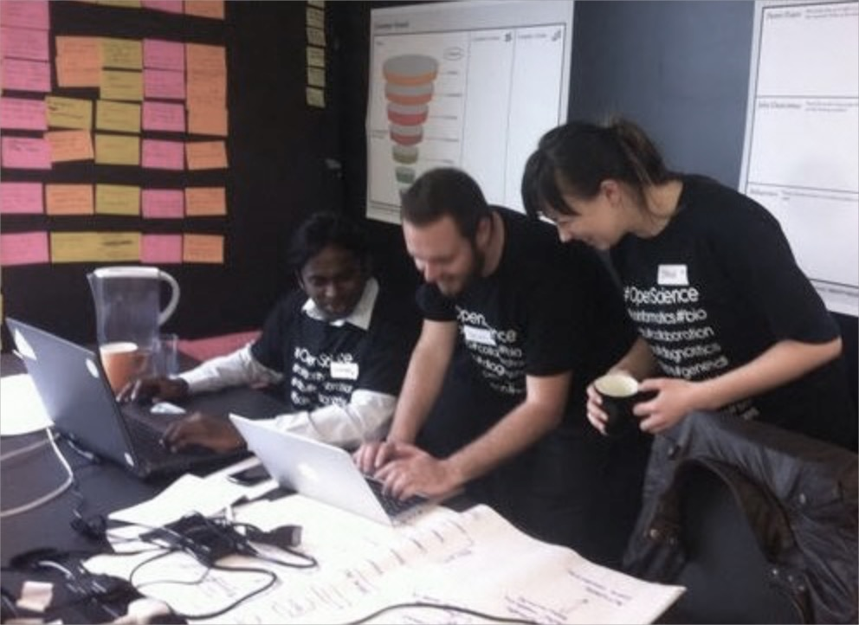
We do events, workshops, hackathons
Latest events: #hackDNA
Symposium on challenges of data sharing in genomics research
ContentMine hackday
Workshop Uni of Cambridge on how to find and access genomics data
Today: #BionodeHack

Slide 8
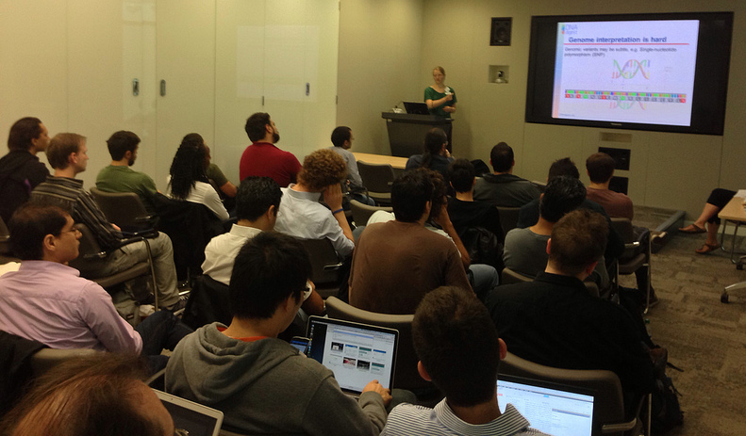
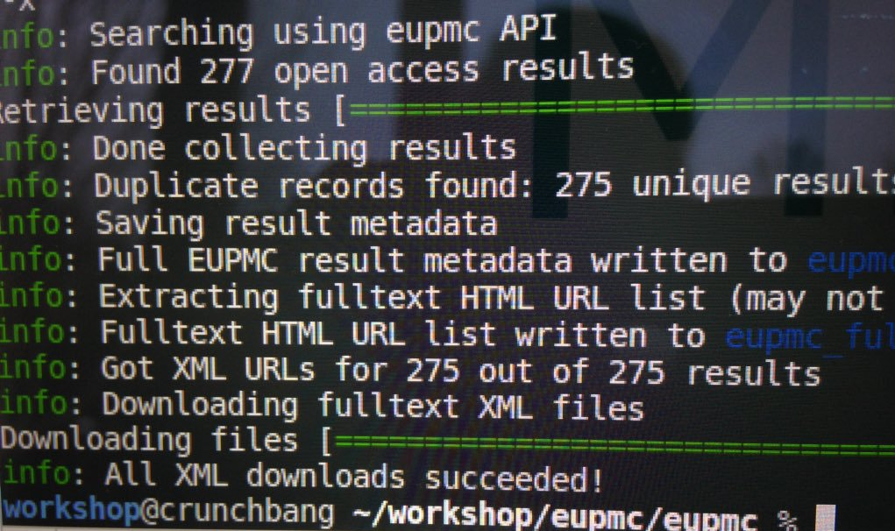
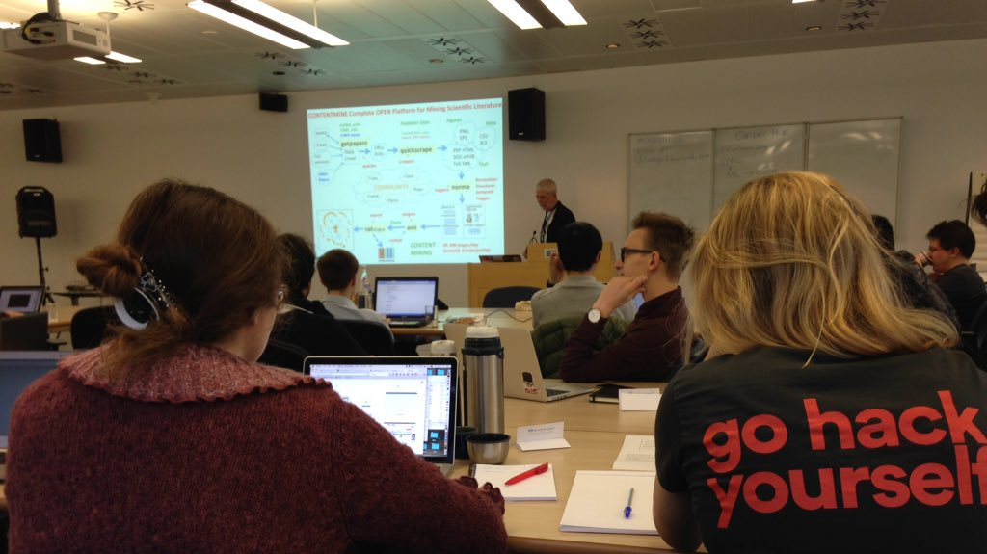
Aim of today
Community learning experience
Share best practices for data access
Have fun! ☺

Slide 9
What will focus on today
Improve the NCBI module - bionode-ncbi.
Prototyping new bionode modules for selected data sources.
Architecture challenges in bionode.io for designing a library of modules for fetching genomic data.
#BionodeHack

Slide 10
Data sources to work with today
Name | Repo name | Organism | Host | Data type | Access
Expression Atlas | bionode-gxa | Multiple | EBI | Expression data | Table / API
European variation archive | bionode-eva | Multiple | EBI | Variant data | API
Gene expression omnibus | bionode-ncbi (geo) | Multiple | NCBI | Expression data | API
Database of Genotypes and Phenotypes | bionode-ncbi (dbgap) | Human | NCBI | Controlled access genomic data | API
Sequence read archive | bionode-ncbi (sra) | Multiple | NCBI | Raw sequence data | API
#BionodeHack

Slide 11
Data sources to work with today
Name | Repo name | Organism | Host | Data type | Access
ENCODE | bionode-encode | Human | Encode | NGS of functional DNA elements | Table
MethyCancer | bionode-mc | Human | Chinese academy of sciences | Methylation data | FTP
Mouse tumor biology | bionode-mtb | PDX / Mouse | Jackson Labs | Patient derived xenograft data | Table
Expression Atlas | bionode-gxa | Multiple | EBI | Expression data | Table / API
Personal genome project | bionode-pgp | Human | Harvard | Personal genotypes | Table
Database of variants | bionode-ncbi (dbvar) | Multiple | NCBI | Variant data | FTP / API
#BionodeHack

Slide 12
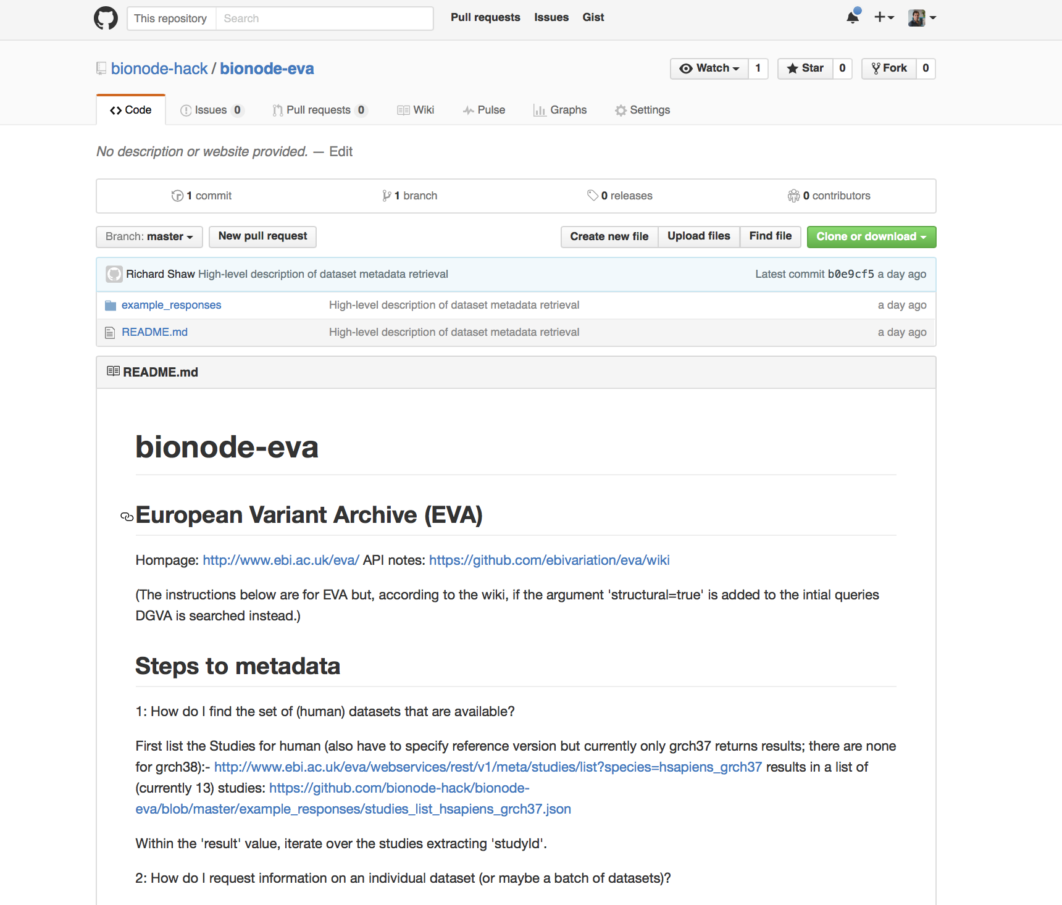
#BionodeHack

Slide 13
What’s in the README.md
Brief description and main URL for the data source
How to find the set of datasets that are available (and relevant, i.e. human) from this data source.
How to request information on individual datasets (or maybe a batch of datasets)
Where to find the dataset attributes and how to get them
Accession number, URL, Title, Description, Technology, Assay type
#BionodeHack

Slide 14
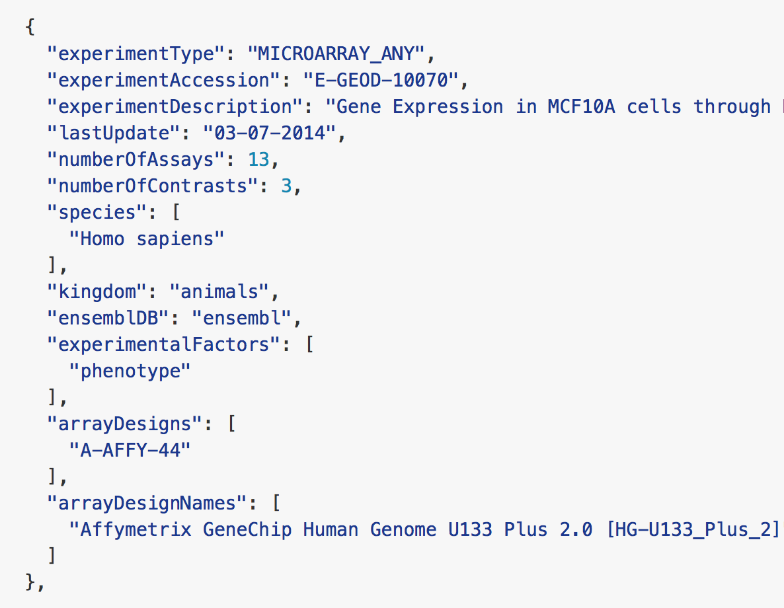
Goal #1
The bionode module should provide functions to get all metadata (description) of datasets from the respective data source.
#BionodeHack

Slide 15
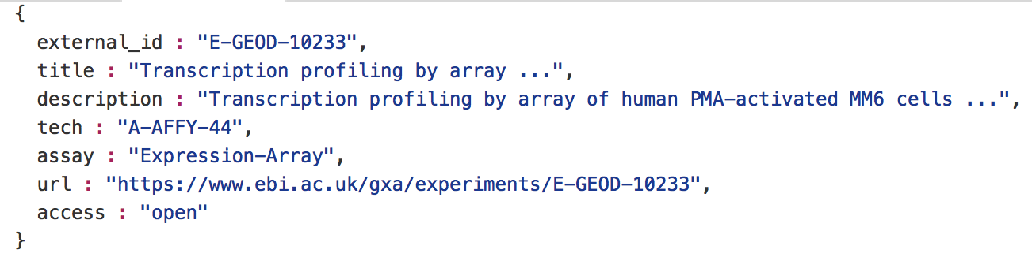
Goal #2
Extract from the the following entities into a JSON:
#BionodeHack

Slide 16
Goal #3
Once the descriptions are fetched and mapped, develop:
Methods to download the raw datasets
Methods for wrapping up API calls to raw data
EVA supports querying alleles from a single position (returns JSON):
www.ebi.ac.uk/eva/webservices/rest/v1/segments/11:128446-128446/variants?species=hsapiens_grch37
EVA also supports variant query by gene:
www.ebi.ac.uk/eva/webservices/rest/v1/genes/PAX6/variants?species=hsapiens_grch37&limit=10
#BionodeHack

Slide 17
Teaming up
Around 5-6 people per team (potentially subdivide in sub-teams)
Who works in science
Who worked with node.js and Streams
Bioinformatics / Computational biology
Who would like to learn node.js / streams
#BionodeHack

Slide 18
Feedback
Before you leave today, we'd be grateful to get your feedback on this event. We want to provide the best events we can, and your input is essential. It only takes 15 seconds, and the feedback form is available at: campus.co/thx1q
In question 3 of the feedback survey, we would be very grateful if you could tell us what you liked and disliked about this hackathon, and why?
This feedback goes both to Campus and DNAdigest
#BionodeHack

Slide 19
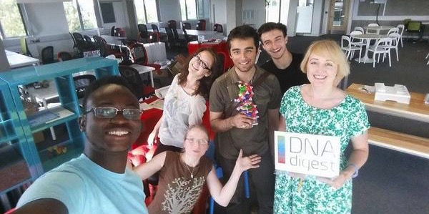
Thanks for joining
#BionodeHack

